Slide 1
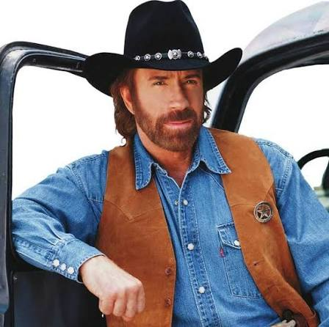
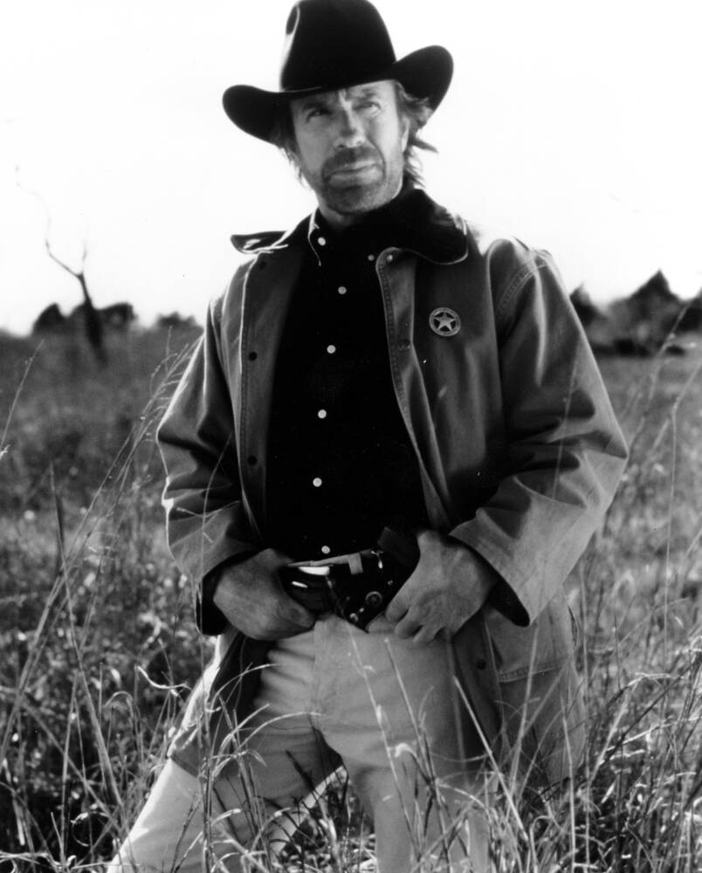
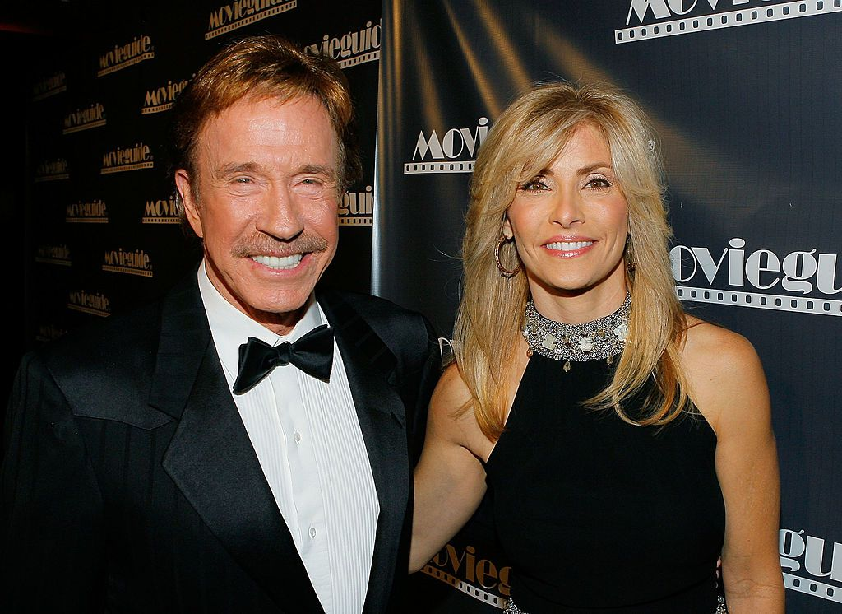
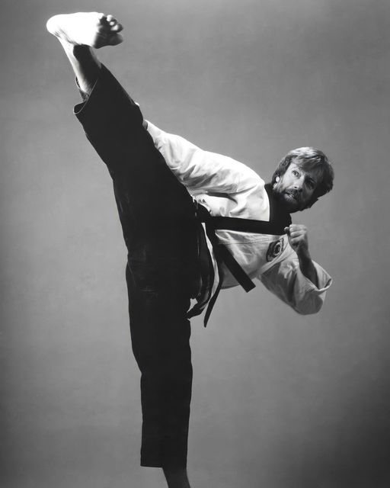

Slide 2
Israel’s Election
“For thou art an holy people unto the Lord thy God: the Lord thy God hath chosen thee to be a special people unto himself, above all people that are upon the face of the earth.”
– Deuteronomy 7:6; 14:2

Slide 3
Israel’s Election
“For thou hast confirmed to thyself thy people Israel to be a people unto thee for ever: and thou, LORD, art become their God.” – II Samuel 7:24

Slide 4
Israel’s Election
“Blessed be the LORD thy God, which delighted in thee, to set thee on the throne of Israel: because the LORD loved Israel for ever, therefore made he thee king, to do judgment and justice.” – I Kings 10:9

Slide 5
Israel’s Election
“He hath remembered his covenant for ever, the word which he commanded to a thousand generations. Which covenant he made with Abraham, and his oath unto Isaac; and confirmed the same unto Jacob for a law, and to Israel for an everlasting covenant.” – Psalm 105:8-10

Slide 6
Israel’s Election
“For the LORD hath chosen Jacob unto himself, and Israel for his peculiar treasure.” – Psalm 135:4

Slide 7
Israel’s Election
“But now thus saith the Lord that created thee, O Jacob, and he that formed thee, O Israel, Fear not: for I have redeemed thee, I have called thee by thy name, thou art mine.” – Isaiah 43:1

Slide 8
Israel’s Election
“Yet now hear, O Jacob my servant; and Israel, whom I have chosen: Thus saith the Lord that made thee, and formed thee from the womb, which will help thee; Fear not, O Jacob, my servant; and thou, Jesurun, whom I have chosen.” – Isaiah 44:1-2

Slide 9
Israel’s Election
“But Zion said, The LORD hath forsaken me, and my LORD hath forgotten me. Can a woman forget her sucking child, that she should not have compassion on the son of her womb? Yea, they may forget, yet I will not forget thee. Behold, I have graven thee upon the palms of my hands; thy walls are continually before me.” – Isaiah 49:14-16

Slide 10
Israel’s Election
“The LORD hath appeared of old unto me, saying, Yea, I have loved thee with an everlasting love: therefore with lovingkindness have I drawn thee.” – Jeremiah 31:3

Slide 11
Israel’s Election
“Thus saith the LORD, which giveth the sun for a light by day, and the ordinances of the moon and of the stars for a light by night . . . If those ordinances depart from before me, saith the LORD, then the seed of Israel also shall cease from being a nation before me for ever.” – Jeremiah 31:35, 36

Slide 12
Israel’s Election
“Thus saith the LORD, If heaven above can be measured, and the foundation of the earth searched out beneath, I will also cast off all the seed of Israel for all that they have done, saith the LORD.” – Jeremiah 31:37

Slide 13
Israel’s Election
“For thus saith the LORD of hosts; After the glory hath he sent me unto the nations which spoiled you: for he that toucheth you toucheth the apple of his eye.“
– Zechariah 2:8

Slide 14
God CHERISHES Israel
Satan HATES Israel
(Revelation 12)
“He was a murderer from the beginning, and abode not in the truth, because there is no truth in him. When he speaketh a lie, he speaketh of his own: for he is a liar, and the father of it.”
– John 8:44

Slide 15
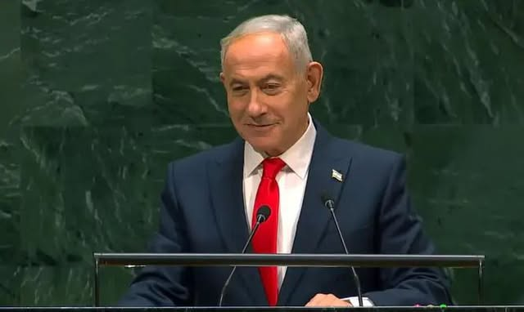
The Genocide Lie
“What genocidal regime gives a million polio vaccinations to the enemy's population?
What genocidal regime enables the distribution of 2 million tons of food into Gaza? That's a ton for every person.
Accusing Israel of genocide is the greatest lie of the century!”
– Benjamin Netanyahu

Slide 16
What is “genocide?”
Genos: race, tribe, people group
The deliberate and systematic killing or persecution of a large number of people from a particular national or ethnic group with the aim of destroying that nation or ethnicity

Slide 17
The Genocide Lie
96% of Jews in Poland were murdered by the Nazis – that’s genocide
3% of Gaza’s population, mostly male combatants, were killed in a war they started. That is not genocide
– Dr. Maalouf on X.com
FACT: The population of Gaza has grown 4% every year since 2023

Slide 18
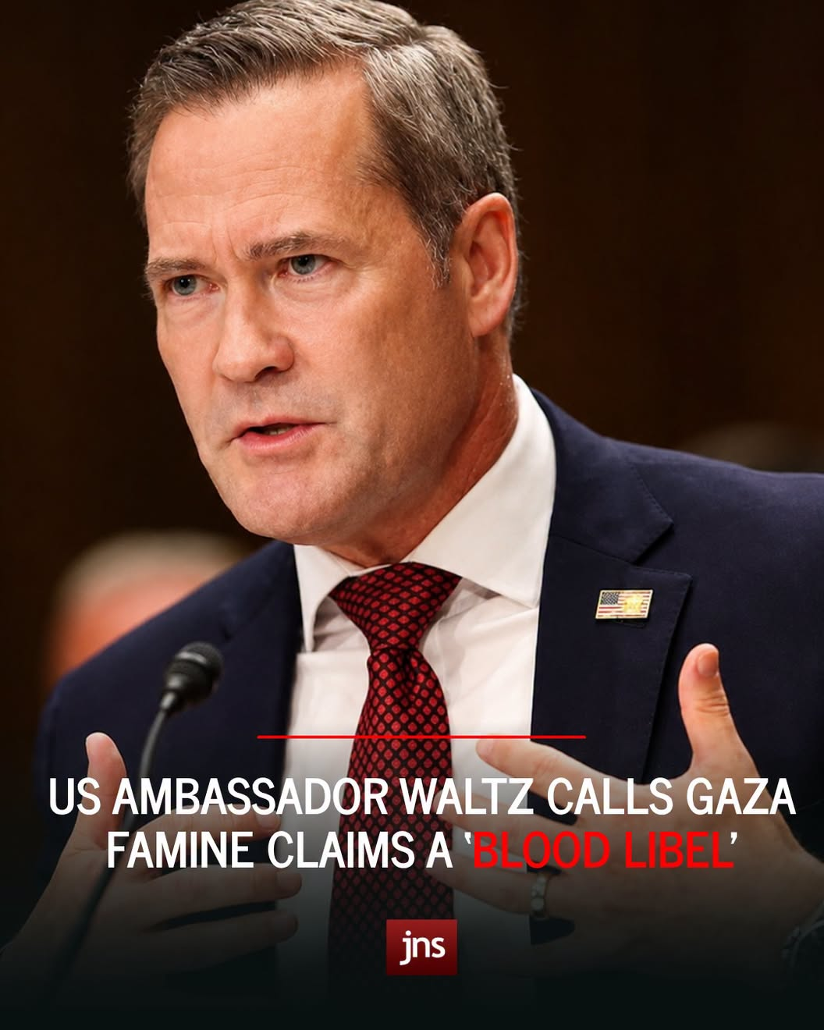
Blood-libel: “The allegation that Jews murder non-Jews, especially Christians, in order to obtain blood for the Passover or other rituals”
– Encyclopedia Judaica

Slide 19
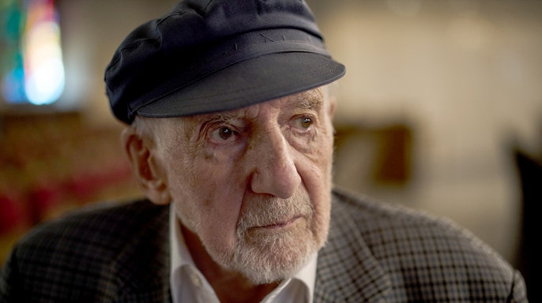
Hatred of Israel/Jews on the rise
Walter Bingham – 101
United Kingdom – 2,000 incidents of antisemitism in 2026
F.B.I. – 69% of religion based hate crimes target Jews
TIME magazine – acts of antisemitism increased 361% from 2023 to 2025
Holocaust survivors – “we live in an era equivalent to Europe in 1938”

Slide 20
Why should it matter to us what happens to Israel?
Because it matters to our Father in Heaven
God has ordained to be glorified through Israel
If God’s promises to Israel have failed, how can we count on His faithfulness to us?
We owe a great debt to the Jews
We will give account for how we treat His chosen people

Slide 21
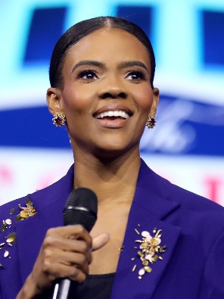
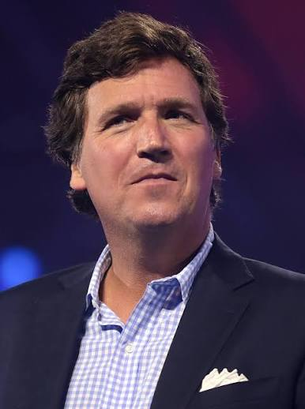
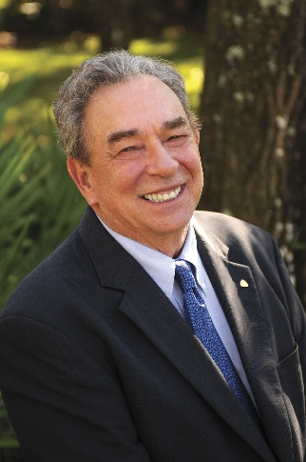
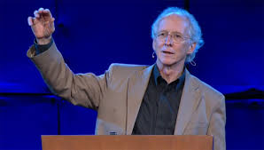
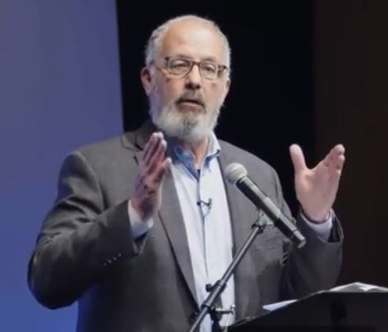
What is “Replacement Theology?”
The belief that the Christian Church has replaced Israel as God’s chosen people, inheriting the covenant promises originally given to the Jewish nation.
– an offshoot of Reformed/Covenant Theology

Slide 22
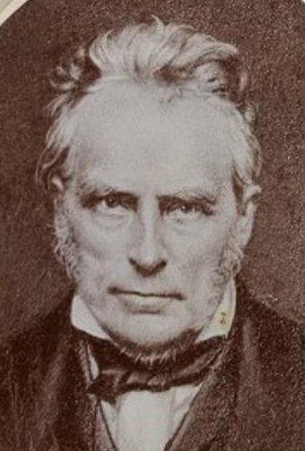
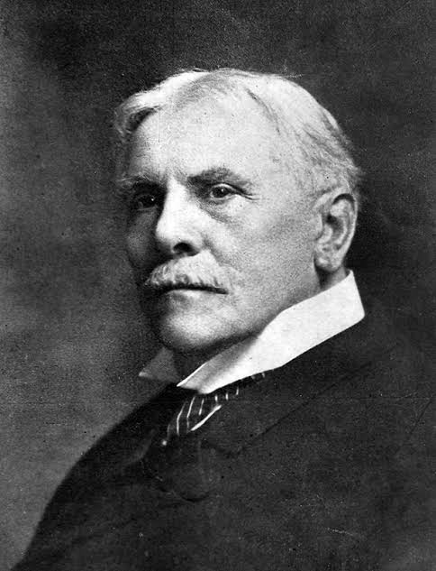
The two “evil masterminds” behind Dispensationalism
False!!
John Nelson Darby
C. I. Scofield

Slide 23
The Election OF GRACE
– Romans 11:5-6
Election = God Choosing
A choosing that is on the basis of GRACE
= God choosing for inheritance, blessing & glory ALL those who receive His Son by GRACE through FAITH

Slide 24
Ethnic Israel
Israel after the flesh
Members thru Physical Birth
Believing Remnant
Children of the Promise
Members by grace thru faith in God’s Promise

Slide 25
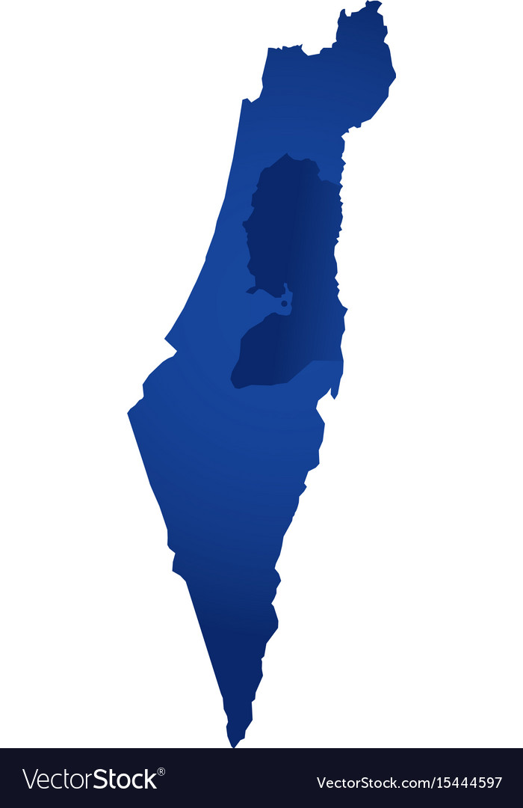
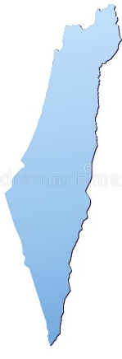

“They are not all Israel which are of Israel” (Ro. 9:6-7)
An “Israel”
within Israel
Israel of Promise
(The Remnant)
Israel after the flesh

Slide 26
“Have they stumbled that they should fall?” – Romans 11:11a
“Stumble” (eptaio) – to trip up temporarily
“Fall” (pesosin) – a permanent fall from which there is no recovery

Slide 27
“Through their fall, salvation is come unto the Gentiles” – Ro. 11:11b
“Fall” (paraptomati) – A false step, a lapse or deviation from truth or uprightness; a “FALL” which is not final.
ISRAEL’S “FALL” IS TEMPORARY

Slide 28
“Life from the Dead”
(Ro. 11:15)
Spiritual LIFE for Israel (Ezek. 37)
Physical regeneration for the earth (Isaiah 35; Matt. 19:28)
Salvation to the Gentile nations

Slide 29
The Olive Tree ≠ the Church
(Ro. 11:16-24)
CONTEXT: NOT individual salvation, but Israel’s place of privilege
Paul viewing Israel & the Gentiles as TWO SEPARATE GROUPS
“branches broken off” = unbelieving Israel now set aside under judgment (Ro. 11:14, 25-28)

Slide 30
Interpretation of the Allegory
(Ro. 11:16-24)
1. Branches = Natural Israelites
2. Wild Olive Tree = All Gentiles
3.Root = Abraham, Isaac and Jacob and the promises made to the fathers
4. Olive Tree = Israel’s place of privilege; Opportunity to ENTER INTO salvation & glorious inheritance

Slide 31
“Thou standest by faith”
(Ro. 11:20)
The Gentile remains in the place of OPPORTUNITY as long as there is general receptivity to the gospel
(Acts 28:28)
“Cut off”
(Ro. 11:22)
= OPPORTUNITY for Gentile privilege taken away

Slide 32
Fulfillment of the New Covenant
(Ro. 11:26-27)
Israel restored and in the land
Enjoying the “rest” of communion with God and the fullness of blessings promised
(Jeremiah 31:31-37; 33:14-26)

Slide 33
Israel’s Present State:
(Ro. 11:28-32)
Judicial Blindness over the nation as a whole
A remnant saved through GRACE
(= Jewish members of the CHURCH)
Future restoration after completion of the Church
Functioning as God’s Kingdom of Priests in the Millennial/Messianic Kingdom

Slide 34
Israel
The Remnant

Slide 35
Israel
Gentile world
Jewish members of Church comprise the Remnant today
The Church
– composed of Jew & Gentile

Slide 36
God's Ultimate Aim in Romans:
– Ro. 11:30-32
MERCY
outpoured to ALL

Slide 37
How unsearchable are His judgments and His ways past finding out
(Ro. 11:33-36)
≠ These things concerning God’s sovereignty, election, etc., are impossible for men to understand
= God’s plans are truly wondrous; beyond man’s ability to imagine or track on his own
(but He has revealed them in His Word)

Slide 38
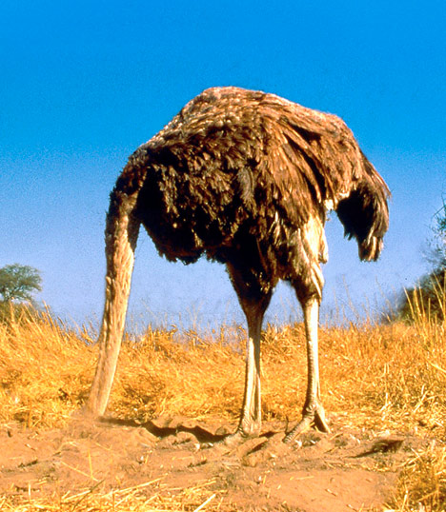
What should we (Christians) do?
Pray for Israel and for the Lord’s will for the Church in these “perilous times” (II Timothy 3:1-5)
Insist on rightly dividing the Word of Truth
Recognize and identify the lies
Stand against antisemitism (Matt. 5:13-14; 25:31-46; Ro. 11:28; Eph. 5:11)

Slide 39
Israel’s Election
“Let them all be confounded and turned back that hate Zion. Let them be as the grass upon the housetops, which withereth afore it groweth up.” – Psalm 129:5-6

Slide 40
Israel’s Election
“Let Israel hope in the Lord: for with the Lord there is mercy, and with him is plenteous redemption. And he shall redeem Israel from all his iniquities.” – Psalm 130:7-8

Slide 41
“And I will cause the captivity of Judah and the captivity of Israel to return, and will build them, as at the first.
And I will cleanse them from all their iniquity, whereby they have sinned against me; and I will pardon all their iniquities, whereby they have sinned, and whereby they have transgressed against me.
And it shall be to me a name of joy, a praise and an honour before all the nations of the earth, which shall hear all the good that I do unto them: and they shall fear and tremble for all the goodness and for all the prosperity that I procure unto it.” – Jeremiah 33:7-9

Slide 42
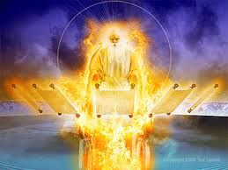
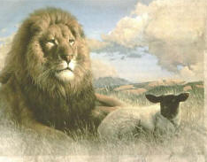
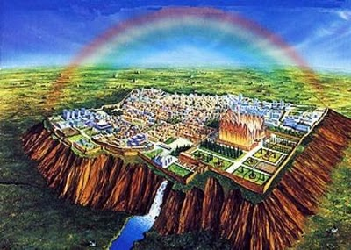
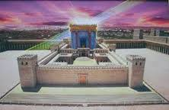
The Messianic Kingdom
Christ will reign over the Earth in righteousness & peace
Israel takes their place as God’s Kingdom of Priests (Exodus 19:5-6)
The curse removed
Israel returned to the paradise of Eden
Satan bound for 1000 years

Slide 43
What is “genocide?”
Genos: race, tribe, people group
Despite its use by the [Genocide Lie] promoters, ‘genocide’ is not a synonym for mass killing, or for a war with heavy civilian losses. It is a specific crime with a specific legal definition, and the gap between its popular use and what it requires in a courtroom is massive.”

Slide 44
Israel’s Election
“For the Lord hath chosen Zion; he hath desired it for his habitation. This is my rest forever; here will I dwell; for I have desired it.” – Psalm 132:13-14

