Slide 1
Caswell Bible Fellowship

Slide 2
Spiritual Gifts
Supernatural Equipment For Spiritual Service
What spiritual gift has God given you?
How are you using it to build up the Body of Christ?

Slide 3
Gifts of the Spirit
1 Corinthians 12:4 There are diversities of gifts, but the same Spirit. 5 There are differences of ministries, but the same Lord. 6 And there are diversities of activities, but it is the same God who works all in all. 7 But the manifestation of the Spirit is given to each one for the profit of all: NKJV
If you are born-again, you have a Spiritual gift. You will NOT thrive, you will NOT flourish in your Christian life unless you are using that Spiritual gift in the context of the local church. You NOT using your Spiritual gift within the local church is also negatively affecting the rest of the body. We’re unhealthy.

Slide 4
Gifts of the Spirit
*Application/Homework*
Do a little survey this week of 3 people that know you well. Ask them this question:
As you have observed me, where do you think I am most gifted?
Prophecy, Service, Teaching, Encouragement/Exhortation, Giving, Mercy, Leadership
(Sermons are uploaded on the CaswellBibleFellowship.org website)

Slide 5
Developing your Spiritual Gift
Accountability, as you will be held responsible for the stewardship of your gift
1 Corinthians 3:10-15
2 Corinthians 5:6-10
The primary question from God that believers will answer at the Judgment Seat of Christ is:
“What did you do with what I gave you?”

Slide 6
Developing your Spiritual Gift
Accountability, as you should be held responsible for the stewardship of your gift
Discipleship Accountability
“What are you doing with what the Lord gave you?”

Slide 7
Spiritual Gifts
The frustration you may feel over things you perceive aren’t being done here will fade when you get involved, actively participating, serving one another in love.
When the individual members are healthy and functioning properly, the body grows and flourishes.
In most local churches a small % of individuals do the work of the ministry. Most local churches have hirelings, a clergy/laity system because of this. We do not see that as the Biblical way for the Church to function.
So, guess what?

Slide 8
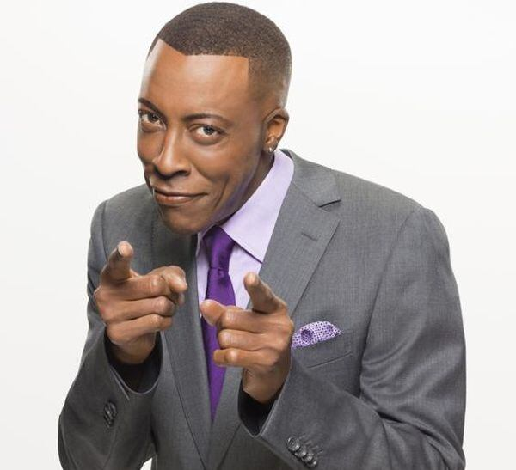
Let’s Get Busy!

Slide 9
Gifts of the Spirit
3 Kinds Of Spiritual Gifts:
Every believer has one primary motivational gift (Romans 12:6-8)
That motivational gift can express itself through a variety of ministry gifts (Ephesians 4, 1 Corinthians 12:28)
When we exercise our motivational gift through our ministry gift the Holy Spirit determines what manifestation or impact the believer will receive (1 Corinthians 12:8-11)
Pg 22

Slide 10
Gifts of the Spirit
"Gifts" "Service" "Workings"
Motivational Ministry Manifestation
Romans 12 Eph 4 / 1 Cor 12:28 1 Cor 12:8-11
*Prophecy *Apostles *Word of Wisdom
*Service *Prophets *Word of Knowledge
*Teaching *Evangelists *Faith
*Encouragement *Pastor / Teacher *Healing
*Giving *Teachers *Miracles
*Leadership *Working of Miracles *Prophecy
*Mercy *Gifts of Healing *Discernment
*Helping *Tongues
*Interpretation of *Administration Tongues

Slide 11
Gifts of the Spirit
The Manifestation (Working) Of Your Gifts
There is a wide range of beliefs and understanding about spiritual gifts. Especially the ones in this category.
Usually within these two camps:
Continuationists – all gifts have continued since Acts 2
Cessationists – some gifts (sign gifts) ceased after the death of the original apostles, or by the time Scripture was canonized.

Slide 12
Gifts of the Spirit
The Manifestation (Working) Of Your Gifts
Wisdom: The ability to apply the principles of God's Word in a practical way to specific situations and then to recommend the best course of action at the best time. The exercise of this gift skillfully distils insight and discernment into excellent advice.

Slide 13
Gifts of the Spirit
The Manifestation (Working) Of Your Gifts
Knowledge: The ability to discover and analyze and systemize truth for the benefit of others. With this gift one speaks with understanding and penetration. But the word of knowledge can also involve supernatural perception and discernment for the purpose of ministering to others.

Slide 14
Gifts of the Spirit
The Manifestation (Working) Of Your Gifts
Faith: The ability to have a vision for what God wants done and to believe confidently that it will be accomplished in spite of circumstances and appearance to the contrary. The gift of faith transforms vision into reality.

Slide 15
Gifts of the Spirit
The Manifestation (Working) Of Your Gifts
Distinguishing of Spirits (Discernment): The ability to discern the spirit of truth from the spirit of error. With this gift one may distinguish reality versus counterfeits, the divine versus the demonic, and true versus false teaching, and in some cases, spiritual versus carnal motives.

Slide 16
Gifts of the Spirit
The Manifestation (Working) Of Your Gifts
Tongues: The ability to receive and impart a spiritual message in a language the recipient has never learned, so that other members of the body may be edified. This message must be interpreted either by the recipient or by another person with the gift of interpretation.
*This is a real, known human language. It is not gibberish, it is not a supposed heavenly language.*

Slide 17
Gifts of the Spirit
The Manifestation (Working) Of Your Gifts
Interpretation of Tongues: This is a God given ability to translate in a language the recipient doesn’t know.
*Again, the tongue/language is a real human language that the interpreter has never studied*

Slide 18
Gifts of the Spirit
The Manifestation (Working) Of Your Gifts
These manifestations, these workings are not the primary gift given to a believer. These are a result of the primary (motivation) gift being used in service (ministry). No Christian should, nor can we say that our main gift is one of these manifestations (workings).
* Word of Wisdom * Word of Knowledge
* Faith * Healing
* Miracles * Prophecy
* Discernment * Tongues
* Interpretation of Tongues

Slide 19
Gifts of the Spirit
Again, developing your spiritual gifts demands that you exercise them by involvement in:
Peoples lives and needs
Church community
On-going training and education
Regular risk taking opportunities
It begins with knowing which of these motivation gifts the Spirit has given you: Prophecy, Service, Teaching, Encouragement/Exhortation, Giving, Mercy, Leadership

Slide 20
Gifts of the Spirit
Developing our spiritual gift means getting involved with people. Where could we use our gift that would get us involved in the lives of people (starting here at CBF)? Be specific.
Be engaged/involved – this is far more than just attending a meeting. It is sharing life with the people. (Discipleship accountability)
Developing our gift is like exercising a muscle and includes ongoing training and education. What kind of training could help you strengthen your gift?
Developing our spiritual gifts means taking risks. We must “jump in the water” of life and people.

Slide 21
Gifts of the Spirit
"Gifts" "Service" "Workings"
Motivational Ministry Manifestation
Romans 12 Eph 4 / 1 Cor 12:28 1 Cor 12:8-11
*Prophecy *Apostles *Word of Wisdom
*Service *Prophets *Word of Knowledge
*Teaching *Evangelists *Faith
*Encouragement *Pastor / Teacher *Healing
*Giving *Teachers *Miracles
*Leadership *Working of Miracles *Prophecy
*Mercy *Gifts of Healing *Discernment
*Helping *Tongues
*Tongues *Interpretation of *Administration Tongues

